Slide 1
File Operations
A file is a collection on information, usually stored on a computer’s disk. Information can be saved to files and then later reused.
All files are assigned a name that is used for identification purposes by the operating system and the user.
Notes:
‹#›

Slide 2
File Class Hierarchy
Base Class
Multiple inheritance
Input
ios
Output
istream
ostream
iostream
iostream.h
fstream.h
ifstream
fstream
ofstream
File I/O
‹#›

Slide 3
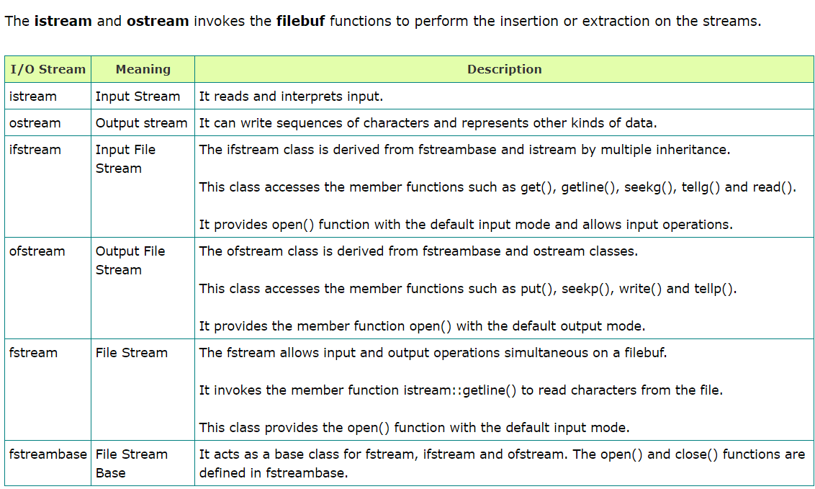

Slide 4
The Process of Using a File
Using a file in a program is a simple three-step process
The file must be opened. If the file does not yet exits, opening it means creating it.
Information is then saved(write) to the file, read from the file, or both.
When the program is finished using the file, the file must be closed.

Slide 5
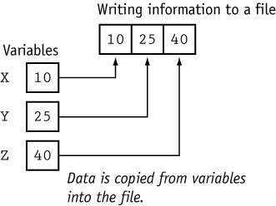
Write to file

Slide 6
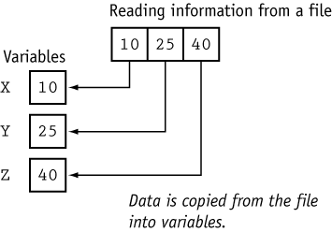
Read from file

Slide 7
Setting Up a Program for File Input/Output
Before file I/O can be performed, a C++ program must be set up properly.
File access requires the inclusion of fstream.h

Slide 8
Opening a File
Before data can be written to or read from a file, the file must be opened.
Open a File
With constructor
b) Open Method

Slide 9
Opening a File
Using Constructor at declartion
fstream dataFile(“names.dat”, ios::in | ios::out);
Using open method
void open(const char* filename, int mode);

Slide 10
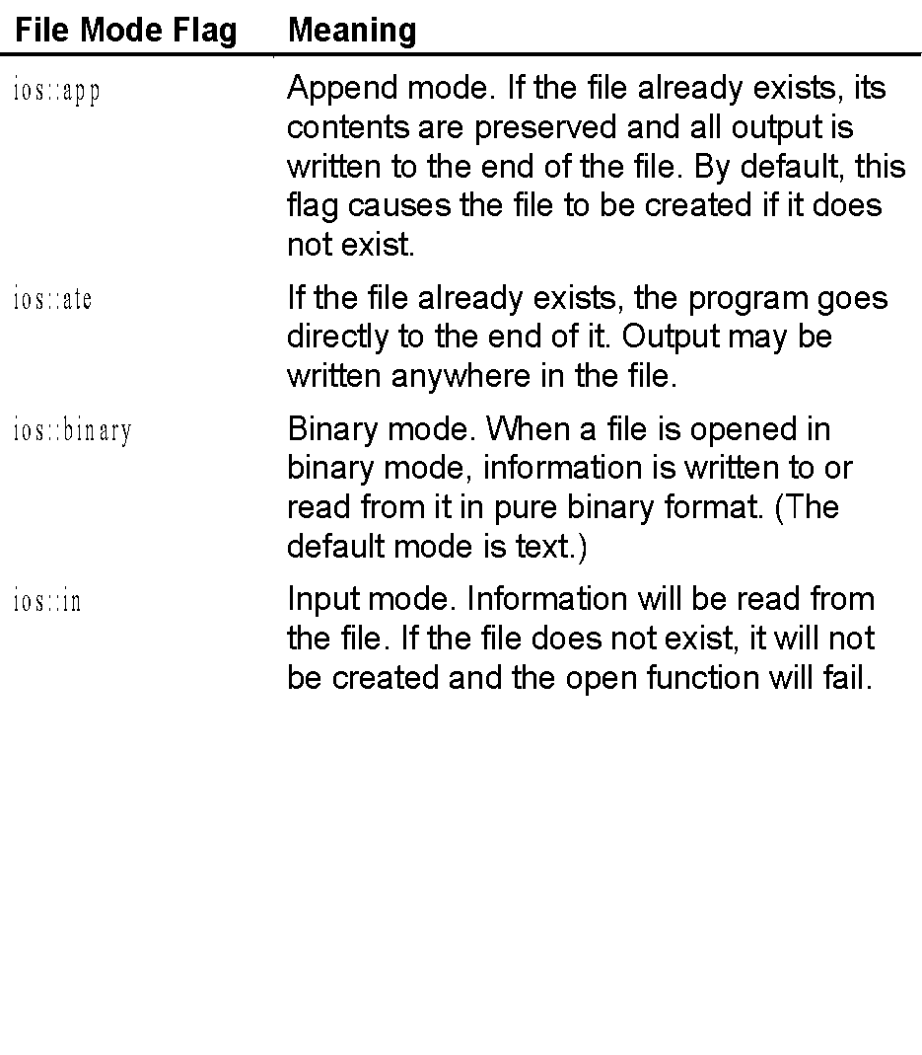
Table

Slide 11
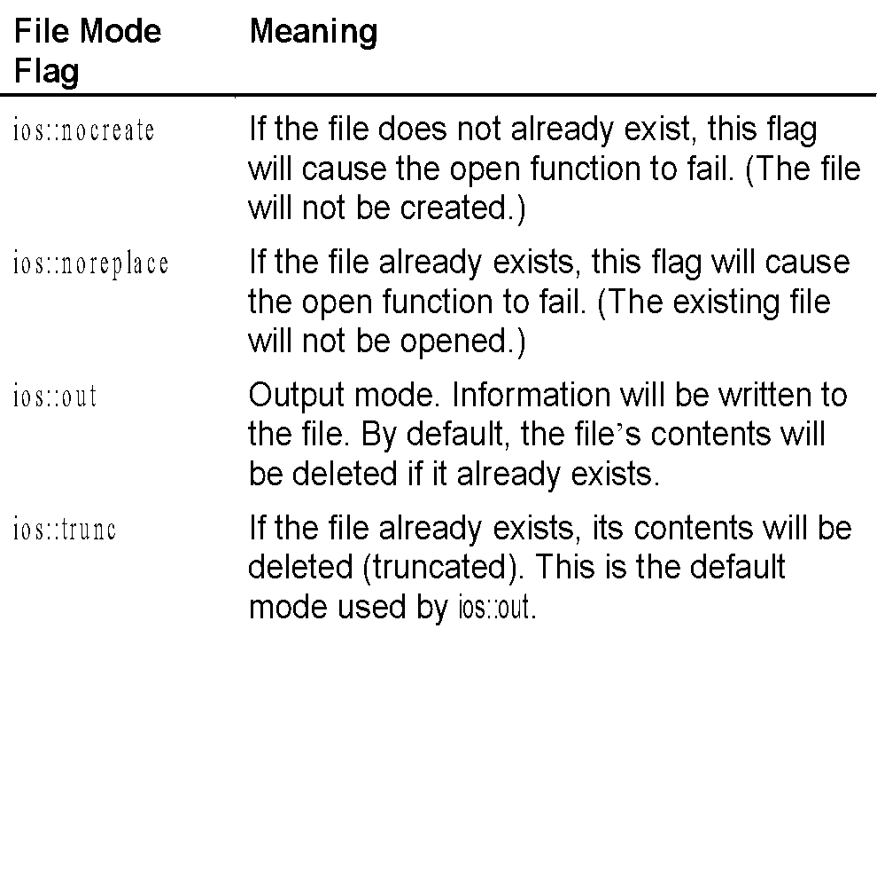
Table

Slide 12
Open & CLOSING
dataFile.open(“cust.dat”, ios::in);
if (!dataFile)
{
cout <<“opened .\n”;
}
………….....
datafile.close();

Slide 13
Closing a File
A file should be closed when a program is finished using it.

Slide 14
Using << to Write Information to a File
The stream insertion operator (<<) may be used to write information to a file.
outputFile << “I love C++ programming !”

Slide 15
Program
// This program uses the << operator to write information to a file.
#include <iostream.h>
#include <fstream.h>
void main(void)
{
fstream dataFile;
char line[81];
dataFile.open("demofile.txt", ios::out);
if (!dataFile)
{
cout << "File open error!" << endl;
return;
}

Slide 16
Program continues
cout << "File opened successfully.\n";
cout << "Now writing information to the file.\n";
dataFile << "Jones\n";
dataFile << "Smith\n";
dataFile << "Willis\n";
dataFile << "Davis\n";
dataFile.close();
cout << "Done.\n";
}

Slide 17
Program Screen Output
File opened successfully.
Now writing information to the file.
Done.
Output to File demofile.txt
Jones
Smith
Willis
Davis

Slide 18

Figure

Slide 19
Program
// This program writes information to a file, closes the file,
// then reopens it and appends more information.
#include <iostream.h>
#include <fstream.h>
void main(void)
{
fstream dataFile;
dataFile.open("demofile.txt", ios::out);
dataFile << "Jones\n";
dataFile << "Smith\n";
dataFile.close();
dataFile.open("demofile.txt", ios::app);
dataFile << "Willis\n";
dataFile << "Davis\n";
dataFile.close();
}

Slide 20
Output to File demofile.txt
Jones
Smith
Willis
Davis

Slide 21
Using >> to Read Information from a File
The stream extraction operator (>>) may be used to read information from a file.

Slide 22
Program
// This program uses the >> operator to read information from a file.
#include <iostream.h>
#include <fstream.h>
void main(void)
{
fstream dataFile;
char name[81];
dataFile.open("demofile.txt", ios::in);
if (!dataFile)
{
cout << "File open error!" << endl;
return;
}
cout << "File opened successfully.\n";
cout << "Now reading information from the file.\n\n";

Slide 23
Program continues
for (int count = 0; count < 4; count++)
{
dataFile >> name;
cout << name << endl;
}
dataFile.close();
cout << "\nDone.\n";
}

Slide 24
Program Screen Output
File opened successfully.
Now reading information from the file.
Jones
Smith
Willis
Davis
Done.

Slide 25
Detecting the End of a File
The eof() member function reports when the end of a file has been encountered.
if (inFile.eof())
inFile.close();

Slide 26
Program
// This program uses the file stream object's eof() member
// function to detect the end of the file.
#include <iostream.h>
#include <fstream.h>
void main(void)
{
fstream dataFile;
char name[81];
dataFile.open("demofile.txt", ios::in);
if (!dataFile)
{
cout << "File open error!" << endl;
return;
}
cout << "File opened successfully.\n";
cout << "Now reading information from the file.\n\n";

Slide 27
Program continues
dataFile >> name; // Read first name from the file
while (!dataFile.eof())
{
cout << name << endl;
dataFile >> name;
}
dataFile.close();
cout << "\nDone.\n";
}

Slide 28
Program Screen Output
File opened successfully.
Now reading information from the file.
Jones
Smith
Willis
Davis
Done.

Slide 29
Note on eof()
In C++, “end of file” doesn’t mean the program is at the last piece of information in the file, but beyond it. The eof() function returns true when there is no more information to be read.

Slide 30
Program 1
#include <iostream>
#include<fstream>
using namespace std;
ofstream out;
ifstream in;
class stu
{ private:
string name;
int rno;
public:
void read() {
in>>name>>rno;
cout<<name<<"\t"<<rno<<endl;
}
void write(){
cin>>name>>rno;
out<<name<<"\t"<<rno<<endl;
}
};
int main(int argc, char** argv) {
out.open("student");
stu s[5];
for(int i=0;i<3;i++)
{
s[i].write();
} out.close();
in.open("student");
for(int i=0;i<3;i++)
{
s[i].read();
}
return 0;
}
Notes:
‹#›

Slide 31
Program 2
#include <iostream>
#include<fstream>
using namespace std;
class stu
{ private:
string name;
int rno;
public:
friend void read();
friend void write();
}s[5];
void write()
{ ofstream out;
out.open("student",ios::out);
for(int i=0;i<3;i++)
{ ci n>>s[i].name>>s[i].rno;
out<<s[i].name<<"\t"<<s[i].rno<<endl;
} out.close();
}
void read()
{
ifstream in;
in.open("student",ios::in);
for(int i=0;i<3;i++)
{
in>>s[i].name>>s[i].rno;
cout<<s[i].name<<"\t"<<s[i].rno<<endl;
}
in.close();
}
int main(int argc, char** argv) {
write();
read();
return 0;
}

Slide 32
Error Handling in File IO
All stream objects have error state bits that indicate the condition of the stream.

Slide 33
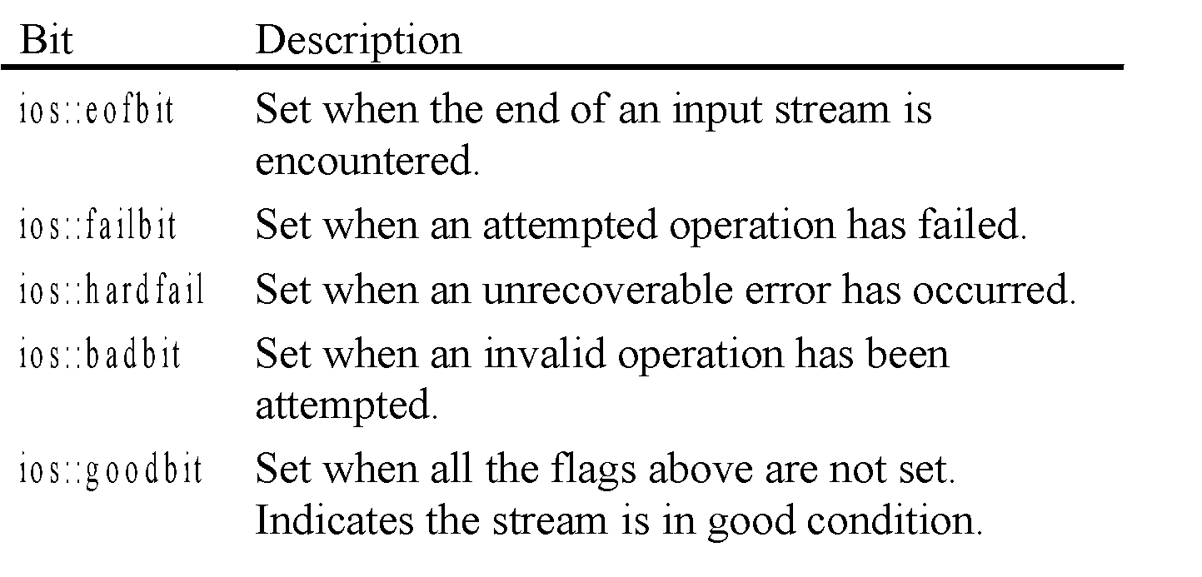
Table

Slide 34
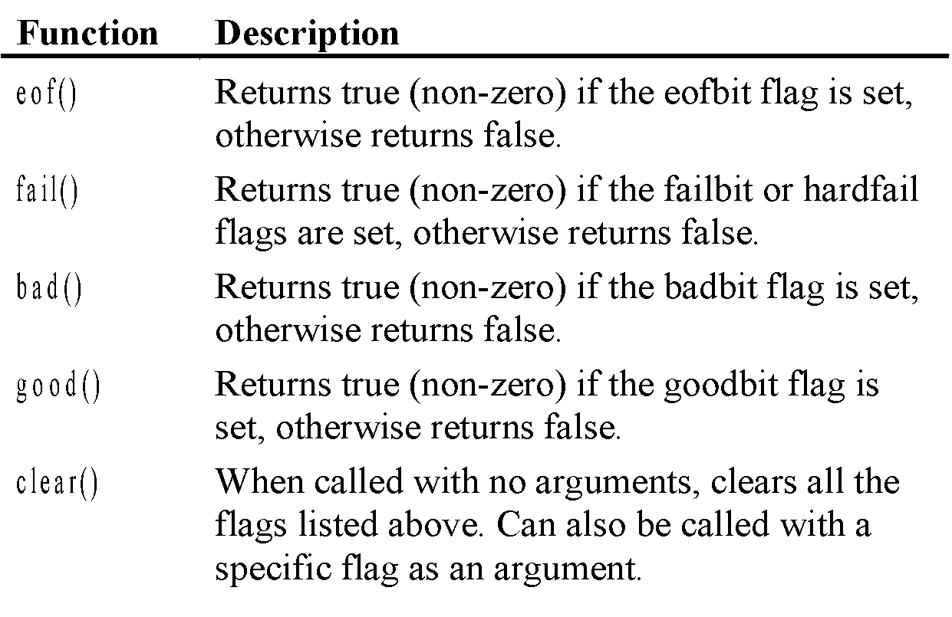
Table

Slide 35
Program
// This program demonstrates the return value of the stream
// object error testing member functions.
#include <iostream.h>
#include <fstream.h>
// Function prototype
void showState(fstream &);
void main(void)
{
fstream testFile("stuff.dat", ios::out);
if (testFile.fail())
{
cout << "cannot open the file.\n";
return;
}

Slide 36
Program continues
int num = 10;
cout << "Writing to the file.\n";
testFile << num; // Write the integer to testFile
showState(testFile);
testFile.close(); // Close the file
testFile.open("stuff.dat", ios::in); // Open for input
if (testFile.fail())
{
cout << "cannot open the file.\n";
return;
}

Slide 37
Program continues
cout << "Reading from the file.\n";
testFile >> num; // Read the only number in the file
showState(testFile);
cout << "Forcing a bad read operation.\n";
testFile >> num; // Force an invalid read operation
showState(testFile);
testFile.close(); // Close the file
}
// Definition of function ShowState. This function uses
// an fstream reference as its parameter. The return values of
// the eof(), fail(), bad(), and good() member functions are
// displayed. The clear() function is called before the function
// returns.

Slide 38
Program continues
void showState(fstream &file)
{
cout << "File Status:\n";
cout << " eof bit: " << file.eof() << endl;
cout << " fail bit: " << file.fail() << endl;
cout << " bad bit: " << file.bad() << endl;
cout << " good bit: " << file.good() << endl;
file.clear(); // Clear any bad bits
}

Slide 39
Member Functions for Reading and Writing Files
File stream objects have member functions for more specialized file reading and writing.

Slide 40
The getline Member Function
dataFile.getline(str, 81, ‘\n’);
str – This is the name of a character array, or a pointer to a section of memory. The information read from the file will be stored here.
81 – This number is one greater than the maximum number of characters to be read. In this example, a maximum of 80 characters will be read.
‘\n’ – This is a delimiter character of your choice. If this delimiter is encountered, it will cause the function to stop reading before it has read the maximum number of characters. (This argument is optional. If it’s left our, ‘\n’ is the default.)

Slide 41
The get Member Function
inFile.get(ch);

Slide 42
The put Member Function
outFile.put(ch);

Slide 43
Binary Files
A binary file stores data to disk in the same form in which it is represented in main memory.
If you ever try to edit a binary file containing numbers you will see that the numbers appear as nonsense characters.

Slide 44
Binary Files
Not having to translate numbers into a readable form makes binary files somewhat more efficient.
Binary files also do not normally use anything to separate the data into lines.
Such a file is just a stream of data with nothing in particular to separate components.

Slide 45
Text Files
Binary Files
When using a text file, we write out separately each of the pieces of data about a given record.
The text file will be readable by an editor
When using a binary file we write whole record data to the file at once.
but the numbers in the binary file will not be readable in this way.

Slide 46
The programs to create the data files will differ in how they open the file and in how they write to the file.
for the text file we will use the usual output operator(<<) and will output each of the pieces of the record separately.
with the text file we will read each of the pieces of record from the file separately, using the usual input operator(>>)
For the binary file we will use write to write to the file,
With the binary file we will use the read function to read a whole record,

Slide 47
:Sequential access. With this type of file access one must read the data in order, much like with a tape, whether the data is really stored on tape or not. Random access (or direct access). This type of file access lets you jump to any location in the file, then to any other, etc., all in a reasonable amount of time.
Types of File Access

Slide 48
FILE POINTERS
Each file object has two integer values associated with it :
get pointer
put pointer
These values specify the byte number in the file where reading or writing will take place.

Slide 49
File pointers…..
By default reading pointer is set at the beginning.
By default writing pointer is set at the end (when you open file in ios::app mode)‏
There are times when you must take control of the file pointers yourself so that you can read from and write to an arbitrary location in the file.

Slide 50
Functions associated with file pointers :
The seekg() and tellg() functions allow you to set and examine the get pointer.
The seekp() and tellp() functions allow you to set and examine the put pointer.

Slide 51
seekg() function : (with one argument)
With one argument :
fl.seekg(k);
fl.seekp(k);
where k is absolute position from the beginning. The start of the file is byte 0
It will result in moving the pointer as shown-
File
End
Begin
k bytes
^
File pointer

Slide 52
‘seek’ functions : (With two arguments )
fl.seekg(offset, refposition);
fl.seekp(offset, refposition);
Number of bytes file
pointer to be moved
Location from where File
pointer is to be moved
Refposition takes one of the following forms :
ios::beg Start of the file
ios::cur current position of the pointer
ios::end End of the file

Slide 53
File Pointer offset calls
fl.seekg(0,ios::beg); Go to start
fl.seekg(0,ios::cur); Stay at the current position
fl.seekg(0,ios::end); Go to the end of file
fl.seekg(m,ios::beg); Move to (m+1)th byte in the file

Slide 54
File Pointer offset calls
fl.seekg(m,ios::cur); Go forward by m bytes
from current pos
fl.seekg(-m,ios::cur); Go backward by m bytes
from current pos
fl.seekg(-m,ios::end); Go backward by m bytes
from the end

Slide 55
seekg() function : (With two arguments )
:
Begin
End
fl.seekg(m,ios::beg);
m bytes
^
Offset from Begin
Move to (m+1)th byte in the file
Begin
End
fl.seekg(-m,ios::cur);
^
m bytes
Offset from end
Go backward by m bytes from the end
Begin
End
fl.seekg(m,ios::cur);
^
m bytes
Offset from current
position
Go forward by m bytes from current pos

Slide 56
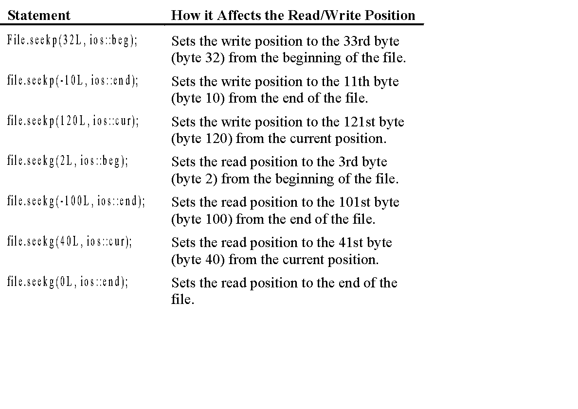
Table

Slide 57
Program
// This program demonstrates the seekg function.
#include <iostream.h>
#include <fstream.h>
void main(void)
{
fstream file("letters.txt", ios::in);
char ch;
file.seekg(5L, ios::beg);
file.get(ch);
cout << "Byte 5 from beginning: " << ch << endl;
file.seekg(-10L, ios::end);
file.get(ch);
cout << "Byte 10 from end: " << ch << endl;

Slide 58
Program continues
file.seekg(3L, ios::cur);
file.get(ch);
cout << "Byte 3 from current: " << ch << endl;
file.close();
}

Slide 59
The tellp and tellg Member Functions
tellp returns a long integer that is the current byte number of the file’s write position.
tellg returns a long integer that is the current byte number of the file’s read position.

Slide 60
Program
// This program demonstrates the tellg function.
#include <iostream.h>
#include <fstream.h>
#include <ctype.h> // For toupper
void main(void)
{
fstream file("letters.txt", ios::in);
long offset;
char ch, again;
do
{
cout << "Currently at position " << file.tellg() << endl;
cout << "Enter an offset from the beginning of the file: ";
cin >> offset;

Slide 61
Program continues
file.seekg(offset, ios::beg);
file.get(ch);
cout << "Character read: " << ch << endl;
cout << "Do it again? ";
cin >> again;
} while (toupper(again) == 'Y');
file.close();
}

Slide 62
Opening a File for Both Input and Output
You may perform input and output on an fstream file without closing it and reopening it.
fstream file(“data.dat”, ios::in | ios::out);

